Slide 1
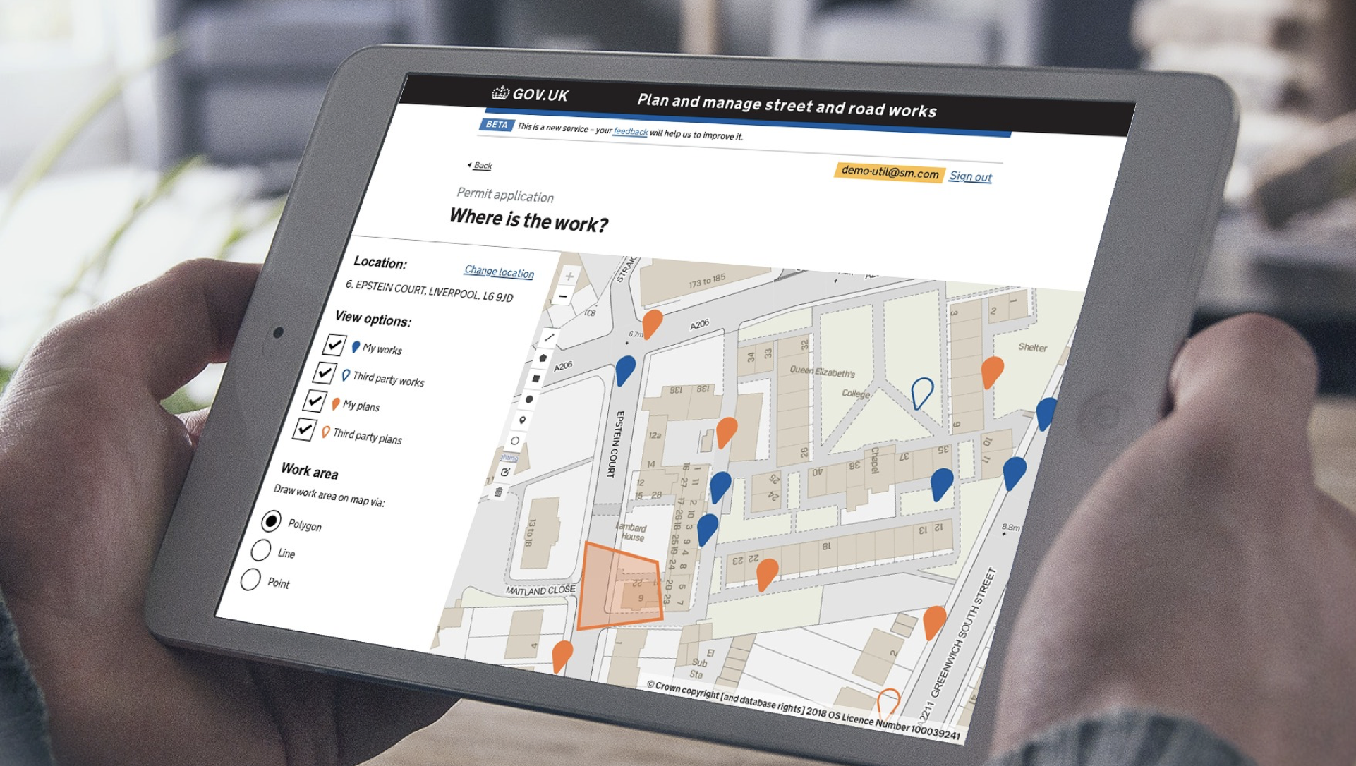

Street Manager Training Pack
August 2019
@ Crown copyright

Slide 2



Contents
Street Manager website
Demo videos of user journey
Shortcuts, hints and tips
Business rules and workflows on Street Manager
Business rules
Process workflows
Business change
Transition guidance and rules
Change management

Slide 3
Street Manager
Website
@ Crown copyright

Slide 4
Street Manager website
We have been creating demo videos that show the user journey on every single functionality of Street Manager including creating and updating permit applications, inspections, applying for early start, exporting, working with maps, etc.
These ‘Hole story’ episodes are all on our DfT Street Manager YouTube channel, and we are adding more content there on a regular basis.
These videos will be the main source of step by step system navigation training, so make sure you check the channel on a regular basis.
Click on the link below to see the YouTube channel:
https://www.youtube.com/channel/UC2U1cjhn4KGPDCwzqc-tvbg/videos?view=0&sort=dd&shelf_id=0

Slide 5
Tips and tricks
To help you navigate easily through the website we will provide you with a number of tips in the form of shortcuts, urls that you can copy and paste onto your browser to land on a specific page, and anything else that can help improve your user journey.
Note that initially the list of those aids might not be very long, but we will be adding to it as we develop further and enhance Street Manager.
If you have identified any hacks that are not among the listed, please do let us know - we really want to make sure that best practice is shared among users!

Slide 6
Tips and tricks
This is a list of Permit Application (PA) flow urls that allow you to skip pages and land on a particular page within the PA.
However, note that you will still need to fill all of the information and go through all pages before submission.
https://www.sandbox.stwrks-dev.net/apply-for-permit/location
https://www.sandbox.stwrks-dev.net/apply-for-permit/people
https://www.sandbox.stwrks-dev.net/apply-for-permit/type
https://www.sandbox.stwrks-dev.net/apply-for-permit/timings
https://www.sandbox.stwrks-dev.net/apply-for-permit/activity
https://www.sandbox.stwrks-dev.net/apply-for-permit/control
https://www.sandbox.stwrks-dev.net/apply-for-permit/coordination
https://www.sandbox.stwrks-dev.net/apply-for-permit/conditions
https://www.sandbox.stwrks-dev.net/apply-for-permit/additional-information
The below shortcut can be used when navigating back to review page after you have finished the PA flow but need to perform some changes. You can navigate to the page that you need and then use the below shortcut to skip the whole flow and just go straight to review:
https://www.sandbox.stwrks-dev.net/apply-for-permit/review

Slide 7
Tips and tricks
When creating Inspections you can start from the login page, or you might find it easier to open a list of works, select the Works Reference Number (WRN) that is needed and then use the Inspection flow:
Make sure that you are logged in as a HA
Go to Permit Applications
Go to Permits in Progress
Select the WRN you need
Click ‘Add inspection’
Fill type, outcome, issues, additional info
Review
Submit
You can stop at any stage, navigate back, change what is needed and proceed with the next pages.

Slide 8
Tips and tricks
Saving work records to your computer AND printing FPN, Permits, work records, any page you want
Convert the browser page into PDF: Click HERE for guidance on how to print to PDF in Internet Explorer, Firefox, Chrome and Safari
Download the PDF to your computer
Print as normal

Slide 9
Street Manager
Business rules and workflows
@ Crown copyright

Slide 10
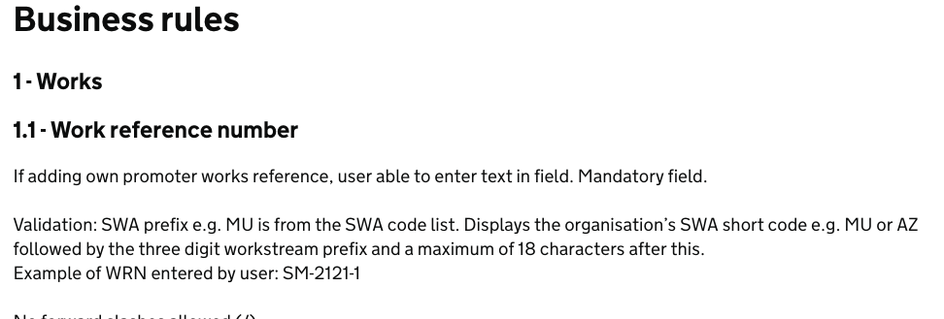
Business rules
Business rules explaining key terms and processes as per the logic of Street Manager can be found on the Github page HERE.
List of business rules available:
Works (Works reference number, Work type, Work category, Permit status, Working day, Calendar day, Deadline date, Early start, PA deeming, Permit conditions)
FPN process and outcomes (FPN status, FPN reference number, Issue date and time, Work ID)
Inspection process and outcomes (Inspection reference number)
Reinstatement process and outcomes (Reinstatement end date, Restrictions to adding a reinstatement, Adding sites and reinstatements to sites, Making interim site permanent, Reinstatement date)
Permit alterations (Types of permit alterations, Raising a permit alteration, Raising a promoter change request, Raising a work extension, Assessing a promoter change request, Viewing permit alterations, Deeming)
Revoking (Revoking a permit)
Cancelling (Cancelling a permit before assessment)
Please note that these are updated regularly to reflect changes to Street Manager. Updates are made on a bi-weekly basis, and for any major changes we will notify you via email.

Slide 11

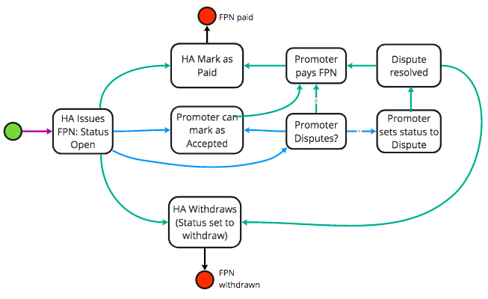
Workflows
Workflows explaining key processes as per the logic of Street Manager can be found on the Github pageHERE.
List of workflows available:
Permit - High level Permit flow logic
Permit - PAA logic flow
High-level FPN flow
High-level inspection flow
Low-level inspection flow
High-level reinstatement flow
Permit Alterations - Change request flow
Permit Alterations - Imposed change
Permit cancelation logic
Please note that these are updated regularly to reflect changes to Street Manager. Updates are made on a bi-weekly basis, and for any major changes we will notify you via email.

Slide 12
Street Manager
Business change:
Transition guidance and Change management
@ Crown copyright

Slide 13



Transition guidance
We have launched a business change edition of the Street Manager newsletter focused on transition, you can find all newsletters HERE.
It will aim to answer so of the most frequently asked questions around transition and provide the guidance needed for organisations to start formalising their transition plan, e.g.:
Adoption options: UI, API, or both
Interaction options between promoters and HAs during transition
Advice on historical data

Slide 14
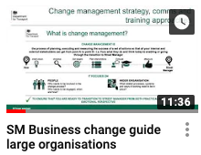



Change management support: summary
Business change will be an essential part of your transition regardless of the specifics of your organisation or the adoption method you decide to use.
To help you manage this side of the move to Street Manager, we have and will continue to provide you with:
Guidance on how to approach change management based on the type of organisation you are part of (e.g. larger vs smaller organisation)
Toolkits, templates and materials you can use
‘How to’ videos focusing on particular elements of business change: Have a look at our latest video on Impact Assessment HERE
Slack channel (#businesschange) to use as a change management dedicated forum for Q&A

Slide 15






Change management toolkits
Business change will be an essential part of your transition regardless of the specifics of your organisation or the adoption method you decide to use.
To help you manage this side of the transition, we created a toolkit (Business Change Playbooks) with guidance, templates, automated tools and best practice on change management, which are available for you to use as you wish. You can find all change management documents HERE
PLAYBOOK PART 1: PLAN
PLAYBOOK PART 2: DELIVER
PLAYBOOK PART 3: MEASURE
Tools to help you understand the impact and how ready you are to embark on the change journey
Change approach to help you address the needs identified from your impact assessment
Tools to monitor your progress and success of interventions
Business case
Impact assessment
Readiness assessment
Stakeholder analysis
Roadmap and delivery plan
Personas and RACI
Risks and actions log
Change management strategy
Comms approach
Training approach
Benefits and progress dashboard
Communications and training needs assessment
Communications and training tracker

Slide 16
Change management: where to start
We recommend that you first look at the videos we have created for
Large and complex organisations, where more focus needs to be put on change management activities: Access video HERE
Small and less complex organisations, which might only need a lighter touch of change management activities: Access video HERE
Once you land on the Business change section of GitHub
you will see that we have developed a suggested checklist for you with recommended order of change management activities that you may like to perform and materials that you might want to look at.
The checklist also provides view of which documents and tools are recommended for everyone, and which ones are more suited to a certain type of organisations: Link to Checklist

Slide 17
Change management: key considerations
The key message when it comes to the Change management documentation provided by DfT is that
It is not compulsory for you to use it - it is there to help you through the transition, but it is up to you if, what and how you want to use
It is not prescriptive - you are free to use the tools, templates and guidance the way it suits you - you can use them as they are, use the full functionality of the tools, use them as registers only to store information, or simply use them as a source of guidance
The information provided there is mainly intended to help your thinking - there are many details relevant to Street Manager, but mainly question to prompt you to come up with answers that are relevant to your specific circumstances
However you decide to use the documents, you will need to add extra details / edit the information to suit your organisation’s needs
Not all documents might be relevant to you - see next slide

Slide 18
Change management:
Documents recommended to everyone
How much time and effort you dedicate on change management is up to you and your capacity constraints. However, as a minimum we recommend that you look at the:
Street Manager overview document
Business case
Impact assessment
Change management strategy
High-level roadmap
Communications and engagement tracker
Risk register
You can find these documents on GitHub

Slide 19


Get in touch with us for any questions
Get in touch with us:
#askthedft
#businesschange
streetmanager@dft.gov.uk

